Slide 1
Digital Display Garden
West Central Research and Outreach Center - Morris, MN

Slide 2
What is Digital Display Garden?
Digital Display Garden is a mobile web application, where your garden visitors can easily find an individual plant/flower information of your garden.
Digital Display Garden allows you to collect and analyze data — feedback about your garden from your garden visitors — in a few simple steps.
West Central Research and Outreach Center - Morris, MN

Slide 3
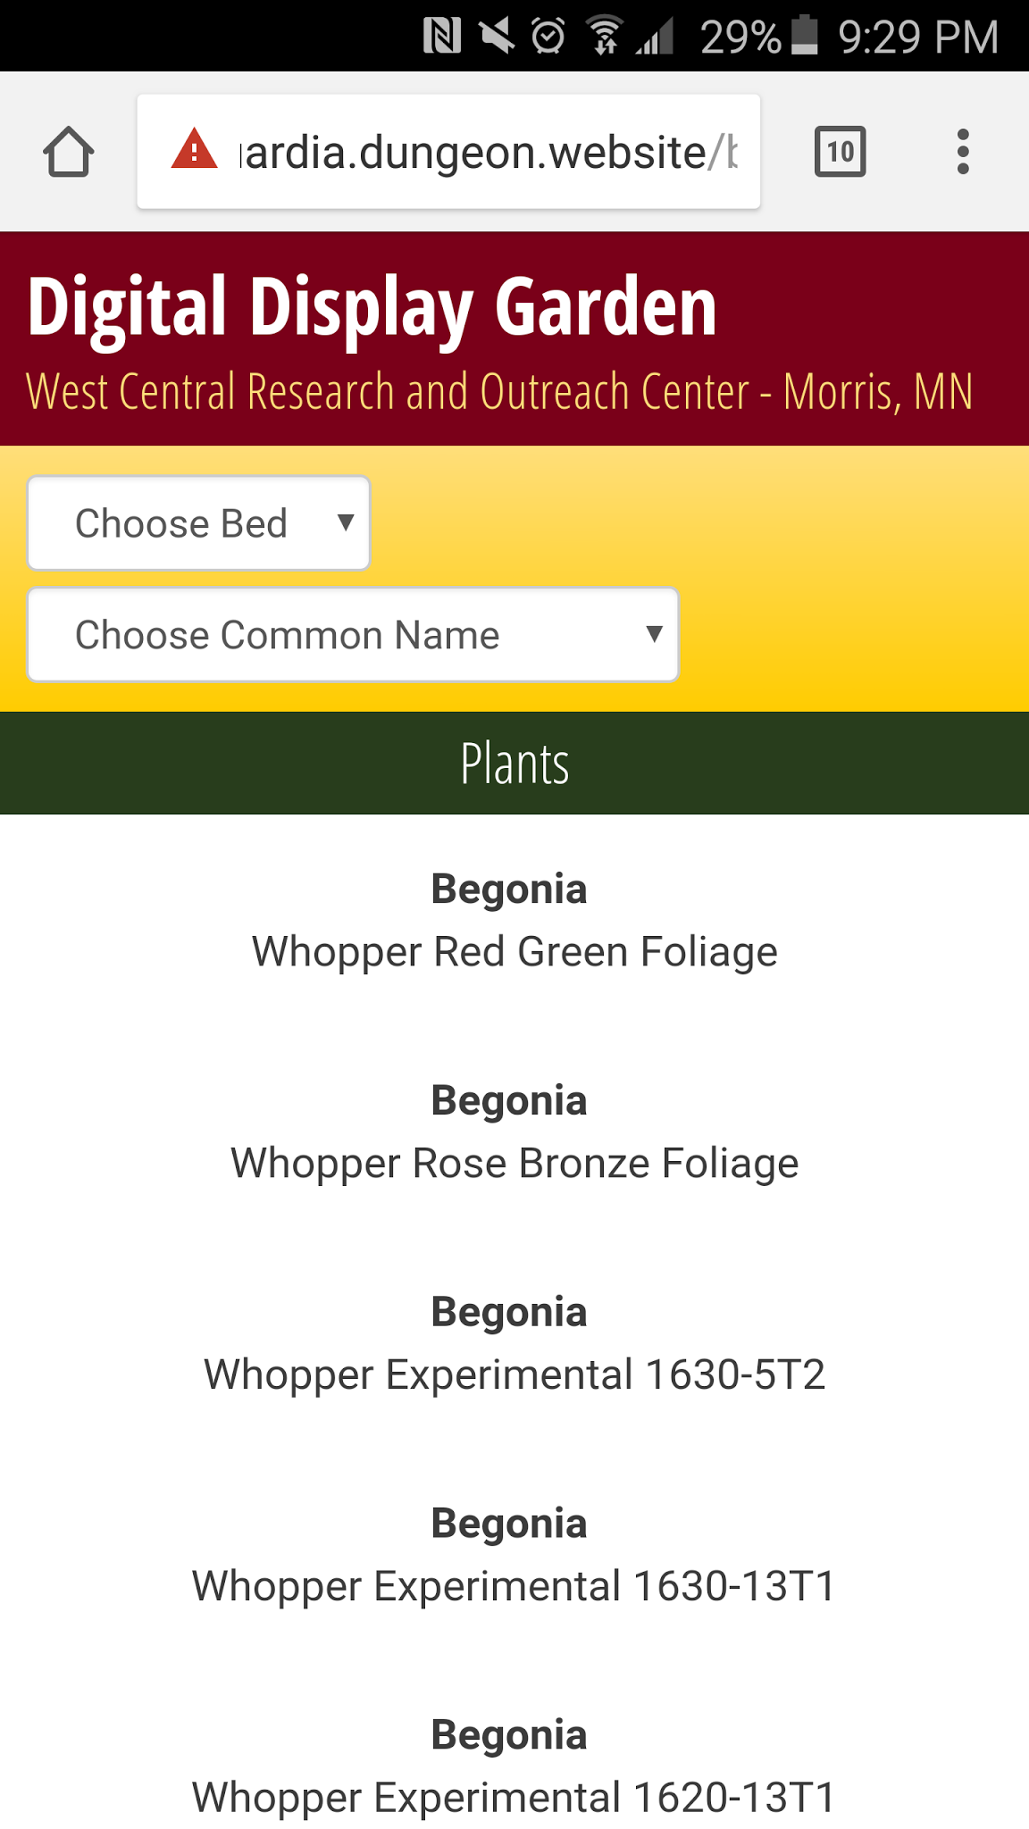
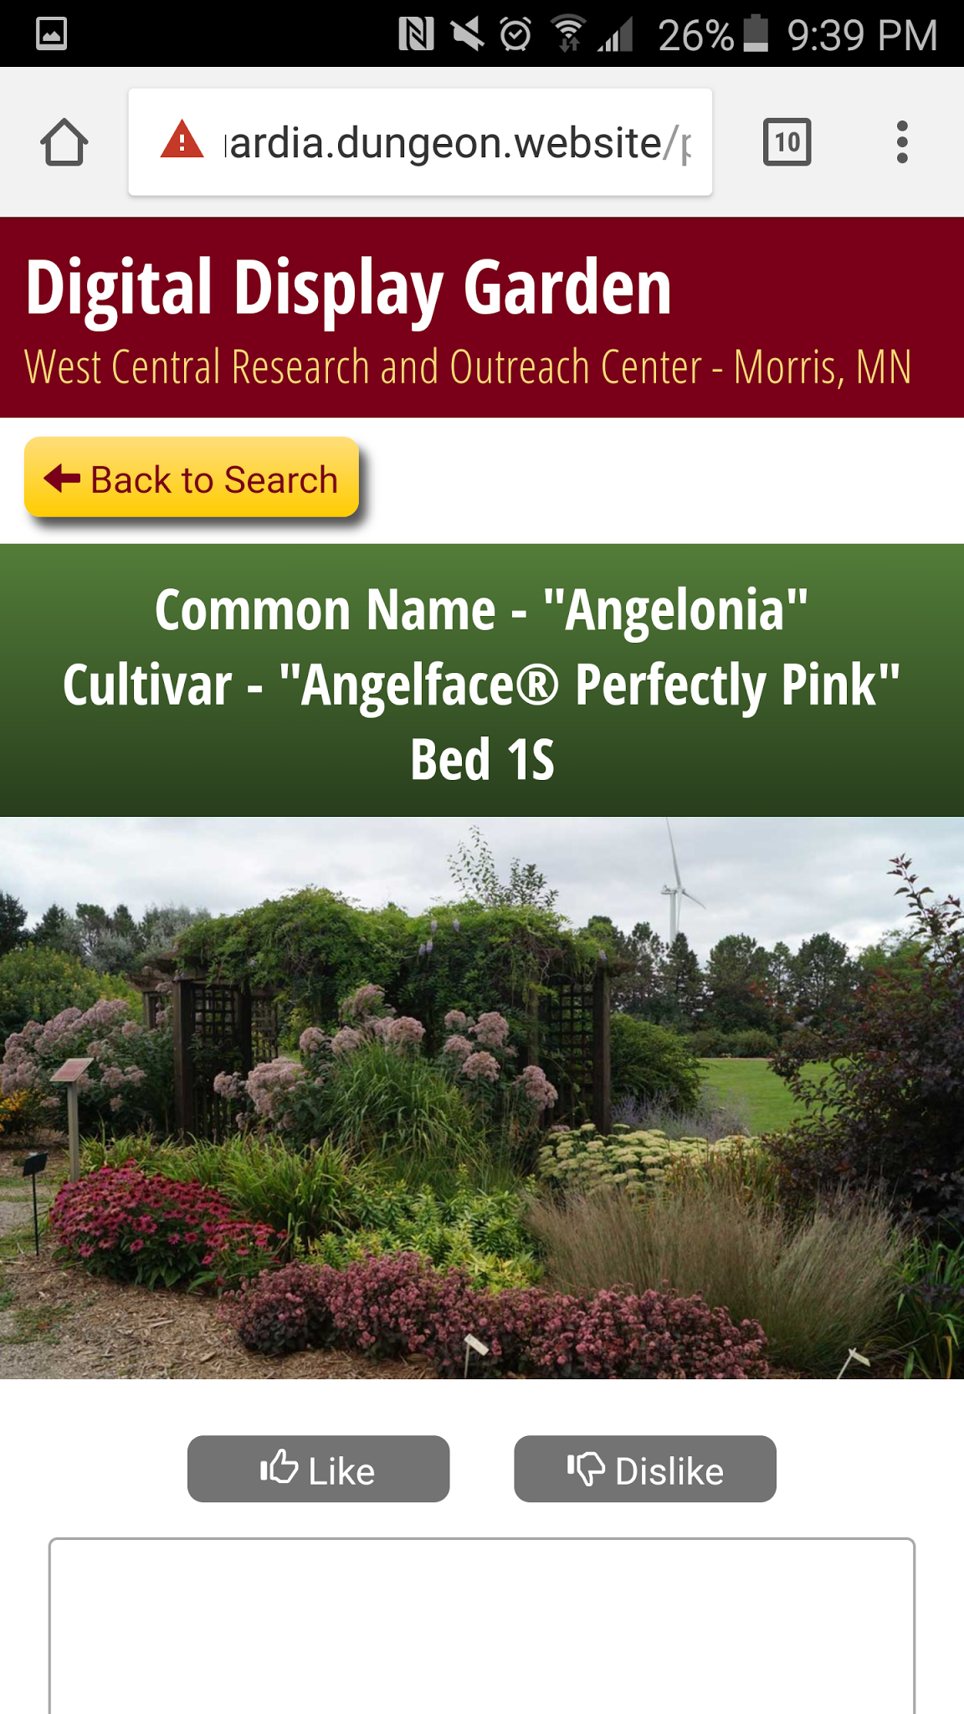
Digital Display Garden for your garden visitors
Digital Display Garden allows your garden visitors to find an individual plant/flower information easily.
Visitors can go to the Digital Display Garden website either by scanning a QR code of a bed or through the website URL.
1
2
Plant/flower information displayed on the Digital Display Garden website is stored in the pre-set database by uploading an excel spreadsheet with plant/flower information.
Digital Display Garden allows you to generate a QR code that you can print out and place at each bed of your garden.
Both these tasks can be easily done with a few clicks.
Digital Display Garden
Main page
Digital Display Garden
Individual plant/flower page
West Central Research and Outreach Center - Morris, MN

Slide 4
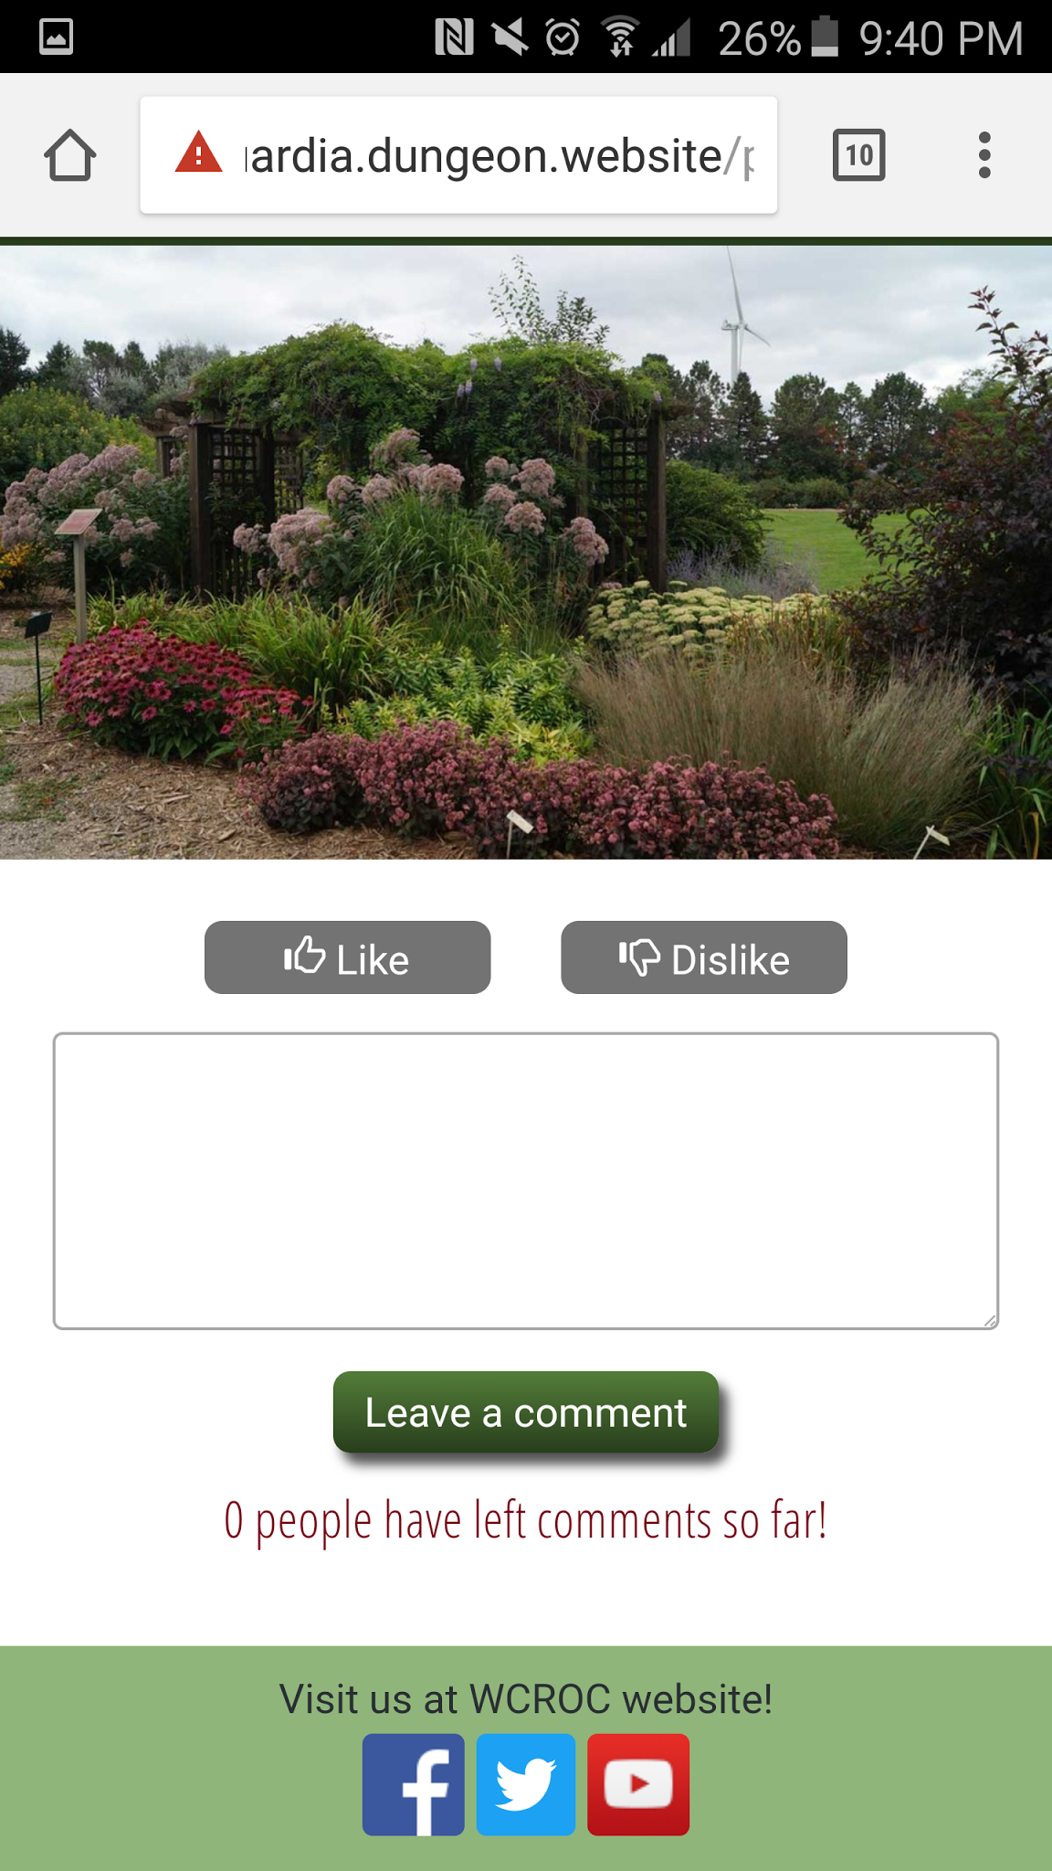
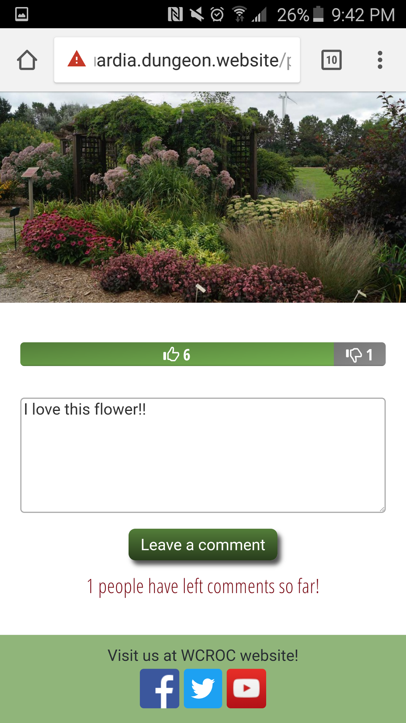
Digital Display Garden for your garden visitors
Your garden visitors can rate an individual plant/flower (like and dislike). After rating a plant/flower, the visitor can see how other visitors have rated the particular plant/flower.
Visitors can also leave a comment about an individual plant/flower. To encourage them to do so, they see how many of other visitors have left comments about the plant/flower.
Individual plant/flower page
Like/Dislike buttons
Individual plant/flower page
Like/Dislike bar and comment box
West Central Research and Outreach Center - Morris, MN

Slide 5
Digital Display Garden for your garden
Feedback (i.e., ratings, comments) from your garden visitors is stored in the pre-set database so you can retrieve the data to learn their thoughts about and reaction to each plant/flower.
There are two ways for you to get/see the collected data. Either way, Digital Display Garden allows you to do it only with a few clicks.
Export raw data in the form of excel spreadsheet.
Get the data that is visualized in the form of Google Charts.
West Central Research and Outreach Center - Morris, MN

Slide 6
Digital Display Garden for your garden
You can export the following raw data in the format of excel spreadsheet with a few clicks.
Data attached to an individual plant/flower
Number of views
Number of likes and dislikes
Number of comments
Comments with timestamp
Data attached to an individual bed
Number of QR scans
Number of views
Raw data in an excel spreadsheet provides you with great flexibility for your analysis of the collected data.
West Central Research and Outreach Center - Morris, MN

Slide 7
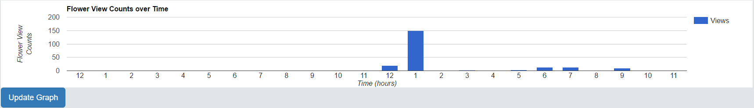
Digital Display Garden for your garden
You can get your collected data that is visualized in the form of Google Charts. Here are some examples of the cool graphs.
Below is a bar graph that charts the number of views for all plants/flowers combined at each hour of the day.
Bar graph for the number of views for all plants/flowers combined at each hour of the day
West Central Research and Outreach Center - Morris, MN

Slide 8
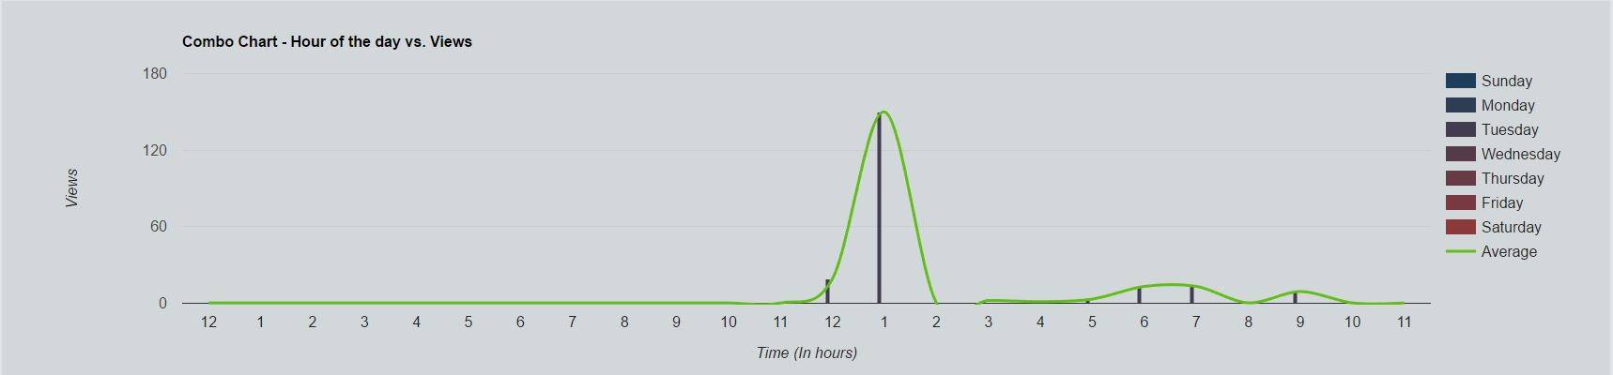
Digital Display Garden for your garden
Here is another example.
Below is a bar graph that charts the number of views for all plants/flowers combined at each hour of the day for each day of the week. The green line represents the average number of views across all days of the week for better visualization of how many people visit your garden at a certain hour.
Bar graph for the number of views for all plants/flowers combined at each hour of the day for each day of the week
West Central Research and Outreach Center - Morris, MN

Slide 9
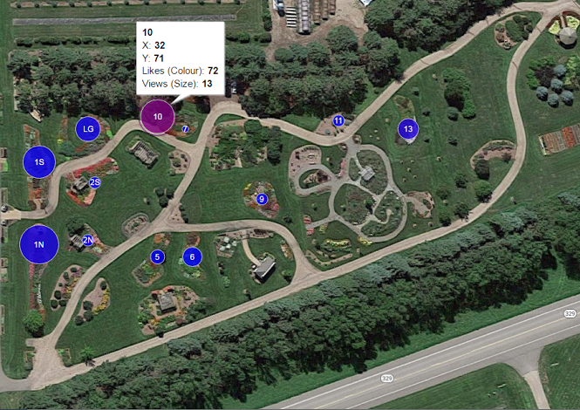
Digital Display Garden for your garden
Here is another example.
This is a “heatmap”, which provides a satellite image of the garden with each bed location labeled. Clicking on one of the circles (i.e., bed), you can see the data of that particular bed — the number of views and likes. The size of the circles represents the number of views; the larger the circle, the larger number of views. The color of the circle shows the number of likes; the more purple, the larger number of likes.
Heatmap for the number of views and likes for individual bed
West Central Research and Outreach Center - Morris, MN

Slide 10
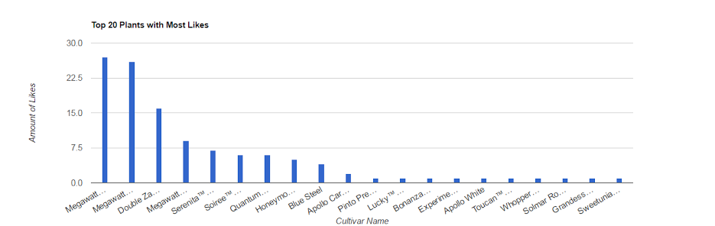
Digital Display Garden for your garden
Here is another example.
Below is a bar graph that charts top 20 plants/flowers with most likes. Digital Display Garden also has bar graphs for top 20 plants/flowers with most dislikes and comments.
Bar graph for top 20 plants/flowers with most likes
West Central Research and Outreach Center - Morris, MN

Slide 11
Digital Display Garden
Would you like to know more about Digital Display Garden?
To see and try its cool features of the visitor’s end, please go to our website https://revolverenguardia.dungeon.website/bed/all.
If you would like to learn more about what you need to do for your administrative part, please let us know so we can share with you another document “How to Use Digital Display Garden — Admin”.
Thank you!
West Central Research and Outreach Center - Morris, MN

